Slide 1
Employee Data Analysis using Excel
STUDENT NAME:I.JULIET GRACY
REGISTER NO:312212121
DEPARTMENT:B.COM(GENERAL)
COLLEGE:MAR GREGORIOS COLLEGE OF ARTS & SCIENCE

Slide 2
PROJECT TITLE
Employee Performance Analysis using Excel

Slide 3


AGENDA
Problem Statement
Project Overview
End Users
Our Solution and Proposition
Dataset Description
Modelling Approach
Results and Discussion
Conclusion
3/21/2024 Annual Review

Slide 4

PROBLEM STATEMENT
The goals to create a performance management framework that employee growth, team effectiveness, and aligns individual contribution with organization.
The strategies consistently show poor performance should be stopped and replaced by others to be effective.
The employee high level performance should be increasing our salary.

Slide 5

PROJECT OVERVIEW
The key performance indicators (KPIs) relevant to the roles within the organization. These may include productivity, quality of work, attendance, rating, and achievements. Therefore , in order to identify for the trends and patterns of different categories of employee such as, high, medium, low.

Slide 6

WHO ARE THE END USERS?
Manager
Employer
Organization
Human resources (HR)
Managing director (MD)

Slide 7

OUR SOLUTION AND ITS VALUE PROPOSITION
Conditional formatting is using for highlight the missing value, because identifying for the blank cells
Filtering is the process of removing the missing cells.
Formula is calculate for the employee performance level, because which employer performance high and low level rating.
A pivot table is a interactive way to quickly summarize a large amount od data.
A graphical display of categorical data that is used to show trendlines over a time.

Slide 8
Dataset Description
Employee dataset – Kaggle
26 features
9 features
Employee ID – number
Employee name – text
Business unit – text
Employee status – text
Gender – male/female
Employee rating – number
Performance – text

Slide 9

THE "WOW" IN OUR SOLUTION
Performance level =IFS(Z8>=5,”VERY HIGH”,Z8>=4,”HIGH”,Z8>=3,”MED”,TRUE,”LOW”)
3/21/2024 Annual Review
9

Slide 10
MODELLING
DATA COLLECTION:
1. Use statistical methods or performance analytics tools to interpret the
collected data and identify trends, strengths, and areas for improvement.
2. Effective data collection will help in making informed decisions about
employee performance and development.
Feature collection:
1. The future of employee performance analysis is likely to be shaped by
technological advancement and evolving workplace dynamics.
2. Future system will leverage data to create highly personalized development
plans and career pathing, aligning with individual strength and areas for
growth.
10

Slide 11
DATA CLEANING:
1. Data cleaning is crucial for ensuring that the data used in employee performance analysis is
accurate, consistent, and useful.
2. Effective data cleaning ensures that the analysis of employee performance is based on accurate
and reliable data
PERFORMANCE LEVEL :
1. The performance levels help in evaluating employee contribution, setting goals, and
identification areas for improvement.
2. They performance level and using effectively, organizations can enhance employee
development, drive better performance and achieve strategic goals.
SUMMARY :
1. The average performance rating per employee, the total revenue generated, and the number of
project completed over a period reflect the performance.

Slide 12
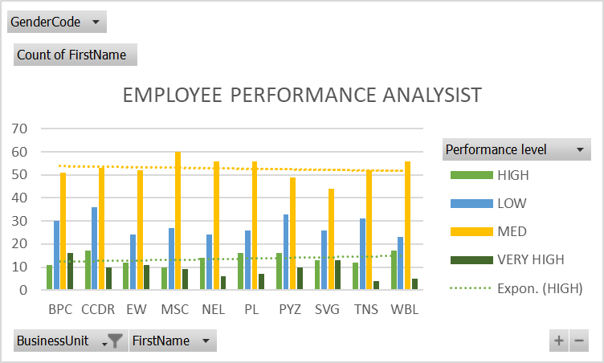
RESULTS
12

Slide 13
conclusion
Employee performance analysis is essential for understanding workforce effectiveness and making informed data.
The pivot table enable dynamic data summarization, allowing you to organize filter performance by different such as employee names, department, and roles.
This facilitates detailed analysis and helps in identifying trends and patterns by them.

